Slide 1


Computer Networks
Data Link Layer –
Concepts
Presented By:
Mr. Ramya Shah
Assistant Professor,
SCSDF, NFSU

Slide 2


who am I ?
Assistant Professor
(Cyber Security & Digital Forensics)
School of Cyber Security & Digital Forensics
National Forensic Sciences University
[An Institution of National Importance]
Mr. Ramya Shah

Slide 3
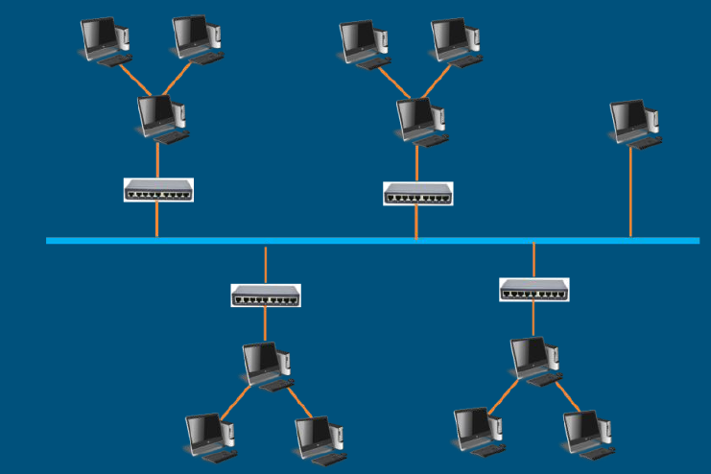
Data Link Layer
The data link layer transforms the physical layer, a raw transmission facility, to a link responsible for node-to-node (hop-to-hop) communication.
The data link layer divides the stream of bits received from the network layer into manageable data units called frames.
The data link layer adds a header to the frame to define the addresses of the sender and receiver of the frame.
If the rate at which the data are absorbed by the receiver is less than the rate at which data are produced in the sender, the data link layer imposes a flow control mechanism to avoid overwhelming the receiver.

Slide 4
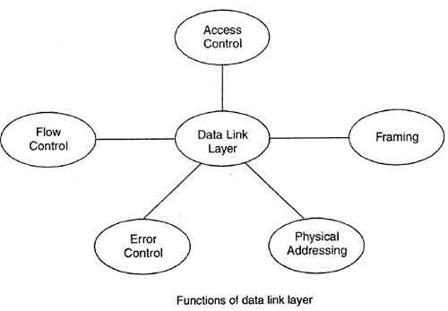
Major Functions of Data Link Layer
The major functions include
Hop-Hop (Node – Node) Delivery
Framing (Bit & Byte Stuffing)
Addressing (Physical Addressing)
Flow Control (SWP, GBN, SR)
Error Control (Error Detection & Error Corelation)
Access Control

Slide 5


Slide 6
Data Link Layer
The data link layer also adds reliability to the physical layer by adding mechanisms to detect and retransmit damaged, duplicate, or lost frames.
When two or more devices are connected to the same link, data link layer protocols are necessary to determine which device has control over the link at any given time.

Slide 7
Framing in Data Link Layer
In the Physical layer, data transmission means moving bits are in the form of a signal from the source to the destination.
The Physical layer also provides synchronization that mainly ensures that the sender and the receiver use the same bit durations and timings.
The data link layer needs to pack bits in frames, so that each frame is distinguishable from another. (Ex. Postal Services)
The simple practice of inserting a letter into an envelope separates one piece of information from another and the envelop serves as delimiter.

Slide 8
Framing in Data Link Layer
The bits to be transmitted is first broken into discrete frames at the data link layer.
In order to guarantee that the bit stream is error free the checksum at each frame is computed.
Breaking the bit stream into frames is called framing.
 | FRAME |  | FRAME |  | Frame
Time Gap
Time Gap
Time Gap

Slide 9
Framing in Data Link Layer
The Framing in the data link layer separates a message from one source to a destination or from other messages to other destinations just by adding a sender address and destination address; where the destination address specifies where the packet has to go and the sender address helps the recipient to acknowledge the receipt.
Frames can be either of fixed size or of variable size. By using frames the data can be easily get broken up into recoverable chunks and in order to check the corruption in transmission, these chunks can be checked easily.

Slide 10
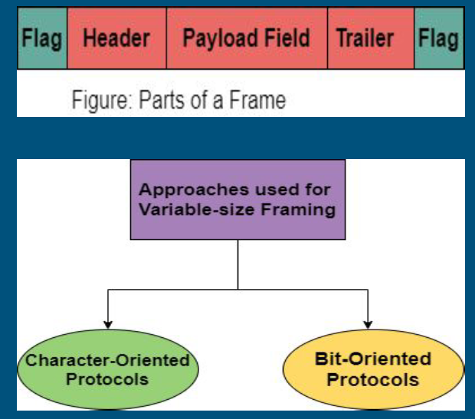
Framing in Data Link Layer
Parts of a Frame :
Flag : A flag is used to mark the beginning and end of the frame.
Header : The frame header mainly contains the address of the source and the destination of the frame.
Trailer
Payload Field

Slide 11
Framing in Data Link Layer
Parts of a Frame :
Flag
Header
Trailer: The frame trailer mainly contains the error detection and error correction bits.
Payload Field : This field contains the message to be delivered.

Slide 12
Framing in Data Link Layer
Character-Oriented Protocol
This technique was popular when the data was in the form of text that was exchanged by the data link layers.
The flag selected could be any character that is not used for text communication. But there is a need to send other types of information like graphs, audio, and video.

Slide 13
Framing in Data Link Layer
Byte Stuffing
It is a process of adding 1 special byte whenever there is a character with the same pattern as the flag.
The data section is stuffed with an extra byte and this byte is usually called the Escape character(ESC) and it has a predefined bit pattern.
Whenever the receiver encounters an ESC character, then it removes it from the data section and then treats the next character as the data.

Slide 14
Framing in Data Link Layer
Bit-Oriented Protocol
The process by which an extra 0 is added whenever five consecutive 1s follow a 0 in the data so that the receiver does not mistake the pattern 01111110 for a flag is commonly referred to as Bit stuffing.

Slide 15
Framing in Data Link Layer
Bit Stuffing
The process by which an extra 0 is added whenever five consecutive 1s follow a 0 in the data so that the receiver does not mistake the pattern 01111110 for a flag is commonly referred to as Bit stuffing.

Slide 16
Flow Control in Data Link Layer
Another important design issue that occurs in the data link layer (and higher layers as well) is what to do with a sender that systematically wants to transmit frames faster than the receiver can accept them.
This situation can occur when the sender is running on a fast, powerful computer and the receiver is running on a slow, low-end machine.
A common situation is when a smart phone requests a Web page from a far more powerful server, which then turns on the fire hose and blasts the data at the poor helpless phone until it is completely swamped. Even if the transmission is error free, the receiver may be unable to handle the frames as fast as they arrive and will lose some.

Slide 17
Flow Control in Data Link Layer
Flow control refers to a set of procedures used to restrict the amount of data that the sender can send before waiting for acknowledgment.
Any receiving device has a limited speed at which it can process incoming data and a limited amount of memory in which to store incoming data. The receiving device must be able to inform the sending device before those limits are reached and to request that the transmitting device send fewer frames or stop temporarily.
For this reason, each receiving device has a block of memory, called a buffer, reserved for storing incoming data until they are processed. If the buffer begins to fill up, the receiver must be able to tell the sender to halt transmission until it is once again able to receive.

Slide 18
Flow Control in Data Link Layer
Flow Control Protocols:-
Stop-and-Wait Protocol
Go-Back-N
Selective Repeat | Sliding Window Protocol

Slide 19
Flow Control in Data Link Layer
In theoretical study, all the protocols we discuss are unidirectional in the sense that the data frames travel from one node, called the sender, to another node, called the receiver. Although special frames, called acknowledgment (ACK) and negative acknowledgment (NAK) can flow in the opposite direction for flow and error control purposes, data flow in only one direction.
In a real-life network, the data link protocols are implemented as bidirectional; data flow in both directions. In these protocols the flow and error control information such as ACKs and NAKs is included in the data frames in a technique called piggybacking. Bidirectional are more complex in nature.

Slide 20
Flow Control in Data Link Layer
Stop and Wait Protocol (Noiseless Channel):
If data frames arrive at the receiver site faster than they can be processed, the frames must be stored until their use. Normally, the receiver does not have enough storage space, especially if it is receiving data from many sources. This may result in either the discarding of frames or denial of service.
To prevent the receiver from becoming overwhelmed with frames, we somehow need to tell the sender to slow down. There must be feedback from the receiver to the sender.
The protocol we discuss now is called the Stop-and-Wait Protocol because the sender sends one frame, stops until it receives confirmation from the receiver (okay to go ahead), and then sends the next frame.

Slide 21
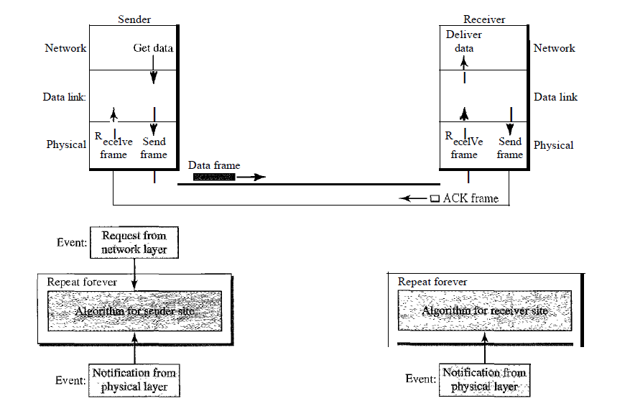
Flow Control in Data Link Layer
Stop and Wait Protocol (Noiseless Channel):

Slide 22
Flow Control in Data Link Layer
Stop and Wait Protocol (Noiseless Channel) :
Stop and Wait Protocol is the simplest flow control protocol.
Efficiency-
Efficiency (η) = Useful Time / Total Time
where-
Useful time = Transmission delay of data packet = (Transmission delay)packet
Useless time = Time for which sender is forced to wait and do nothing = 2 x Propagation delay
Total time = Useful time + Useless time

Slide 23
Flow Control in Data Link Layer
Stop and Wait Protocol (Noiseless Channel):
Stop and Wait Protocol is the simplest flow control protocol.
Efficiency-
Efficiency (η) = Useful Time / Total Time
where-
Useful time = Transmission delay of data packet = (Transmission delay)packet
Useless time = Time for which sender is forced to wait and do nothing = 2 x Propagation delay
Total time = Useful time + Useless time

Slide 24
Flow Control in Data Link Layer
Stop and Wait Protocol (Noiseless Channel):
Stop and Wait Protocol is the simplest flow control protocol.
Efficiency-
Efficiency (η) = Useful Time / Total Time
where-
Useful time = Transmission delay of data packet = (Transmission delay)packet
Useless time = Time for which sender is forced to wait and do nothing = 2 x Propagation delay
Total time = Useful time + Useless time

Slide 25
Error Control in Data Link Layer
Error control is both error detection and error correction. It allows the receiver to inform the sender of any frames lost or damaged in transmission and coordinates the retransmission of those frames by the sender. In the data link layer, the term error control refers primarily to methods of error detection and retransmission.
Error control in the data link layer is often implemented simply: Any time an error is detected in an exchange, specified frames are retransmitted. This process is called automatic repeat request (ARQ).
Error control in the data link layer is based on automatic repeat request, which is the retransmission of data.

Slide 26
Flow & Error Control in Data Link Layer
Stop and Wait ARQ (Automatic Repeat Request Protocol (Noisy Channel):
Stop-and-Wait Automatic Repeat Request (Stop-andWait ARQ), adds a simple error control mechanism to the Stop-and-Wait Protocol.
To detect and correct corrupted frames, we need to add redundancy bits to our data frame. When the frame arrives at the receiver site, it is checked and if it is corrupted, it is silently discarded. The detection of errors in this protocol is manifested by the silence of the receiver.

Slide 27
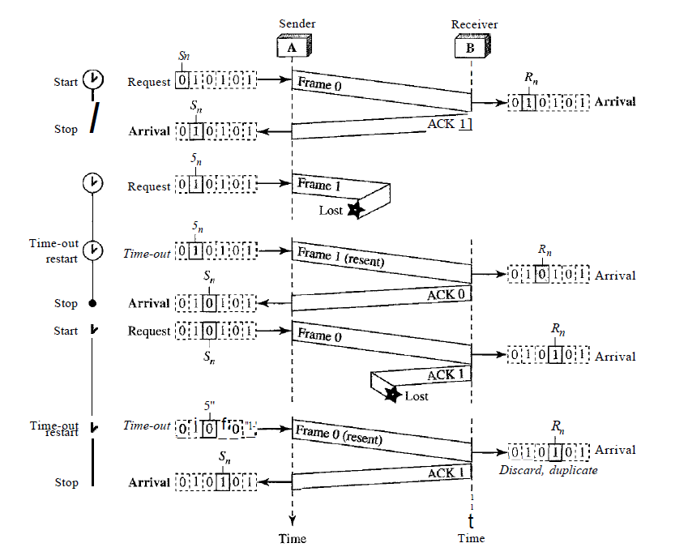
Flow & Error Control in Data Link Layer
Stop and Wait ARQ (Automatic Repeat Request Protocol (Noisy Channel):

Slide 28
Flow & Error Control in Data Link Layer
Stop and Wait ARQ (Automatic Repeat Request Protocol (Noisy Channel):
Lost frames are more difficult to handle than corrupted ones. In our previous protocols, there was no way to identify a frame. The received frame could be the correct one, or a duplicate, or a frame out of order.
The solution is to number the frames. When the receiver receives a data frame that is out of order, this means that frames were either lost or duplicated.
Error correction in Stop-and-Wait ARQ is done by keeping a copy of the sent frame and retransmitting of the frame when the timer expires.

Slide 29
Flow & Error Control in Data Link Layer
Stop and Wait ARQ (Automatic Repeat Request Protocol (Noisy Channel):
Lost frames are more difficult to handle than corrupted ones. In our previous protocols, there was no way to identify a frame. The received frame could be the correct one, or a duplicate, or a frame out of order.
The solution is to number the frames. When the receiver receives a data frame that is out of order, this means that frames were either lost or duplicated.
Error correction in Stop-and-Wait ARQ is done by keeping a copy of the sent frame and retransmitting of the frame when the timer expires.

Slide 30
Flow & Error Control in Data Link Layer
Stop and Wait ARQ (Automatic Repeat Request Protocol (Noisy Channel):
The completed and lost frames need to be resent in this protocol. If the receiver does not respond when there is an error, how can the sender know which frame to resend?
To remedy this problem, the sender keeps a copy of the sent frame. At the same time, it starts a timer.
If the timer expires and there is no ACK for the sent frame, the frame is resent, the copy is held, and the timer is restarted.
Since the protocol uses the stop-and-wait mechanism, there is only one specific frame that needs an ACK even though several copies of the same frame can be in the network.

Slide 31
Flow & Error Control in Data Link Layer
Stop and Wait ARQ (Automatic Repeat Request Protocol (Noisy Channel): How to add sequence Number
The protocol specifies that frames need to be numbered. This is done by using sequence numbers. A field is added to the data frame to hold the sequence number of that frame.
For example, if we decide that the field is m bits long, the sequence numbers start from 0, go to 2^m - 1, and then are repeated.

Slide 32
Flow & Error Control in Data Link Layer
Stop and Wait ARQ (Automatic Repeat Request Protocol (Noisy Channel): How to add sequence Number
The acknowledgment numbers always announce the sequence number of the next frame expected by the receiver. For example, if frame 0 has arrived safe and sound, the receiver sends an ACK frame with acknowledgment 1 (meaning frame 1 is expected next). If frame 1 has arrived safe and sound, the receiver sends an ACK frame with acknowledgment 0 (meaning frame 0 is expected).

Slide 33
Flow & Error Control in Data Link Layer
Stop and Wait ARQ (Automatic Repeat Request Protocol (Noisy Channel)
The Stop-and-WaitARQ is very inefficient if our channel is thick and long.
By thick, we mean that our channel has a large bandwidth; by long, we mean the round-trip delay is long. The product of these two is called the bandwidthdelay product. (BDP = Bandwidth(in bits) * RoundTrip(in seconds)).
The bandwidth-delay product then is the volume of the pipe in bits. The pipe is always there. If we do not use it, we are inefficient. The bandwidth-delay product is a measure of the number of bits we can send out of our system while waiting for news from the receiver.

Slide 34
Flow & Error Control in Data Link Layer
Stop and Wait ARQ – SUM 1
Assume that, in a Stop-and-Wait ARQ system, the bandwidth of the line is 1 Mbps, and 1 bit takes 20 ms to make a round trip. What is the bandwidth-delay product? If the system data frames are 1000 bits in length, what is the utilization percentage of the link?

Slide 35
Flow & Error Control in Data Link Layer
Stop and Wait ARQ – SUM 1
Solution: (1*10^6) * (20*10^-3) = 20,000 bits is the bandwidth-delay.
The capacity is 20,000 bits per second, whereas the the system sends only 1000 bits.
So the utilization is only = (1000*100)/20,000, or 5 percent

Slide 36
Flow & Error Control in Data Link Layer
Stop and Wait ARQ – SUM 2
What is the utilization percentage of the link where the bandwidth of the line is 1 Mbps, and 1 bit takes 20 ms to make a round trip, if we have a protocol that can send up to 15 frames before stopping and worrying about the acknowledgments?

Slide 37
Flow & Error Control in Data Link Layer
Stop and Wait ARQ – SUM 1
Solution: (1*10^6) * (20*10^-3) = 20,000 bits is the bandwidth-delay.
The system can send up to 15 frames or 15,000 bits during a round trip. (1 frame is 1000 bits)
So the utilization is only = (15000*100)/20,000, or 75 percent

Slide 38
Flow & Error Control in Data Link Layer
Stop and Wait ARQ – SUM 3 (Self Exercise)
If the bandwidth of the line is 1.5 Mbps, RTT (Round Trip Time) is 45 msec and packet size is 1 KB, then find the link utilization in stop and wait.

Slide 39
Flow & Error Control in Data Link Layer
Stop and Wait ARQ – SUM 4 (Self Exercise)
A sender uses the SWP – ARQ for reliable transmission of frames. Frames are of size 1000 bytes and the transmission rate at the sender is 80 Kbps. Size of Acknowledgement is 100 bytes and the transmission rate at the receiver is 8 Kbps. The one way propagation delay is 100 msec. Assuming no frame is lost, the sender throughput is ________ Bytes/Second.

Slide 40
Flow & Error Control in Data Link Layer
Stop and Wait ARQ – SUM 5 (Self Exercise)
Suppose that the SWP protocol is used on the link with a bit rate of 64Kbps and 20msec propagation delay. Assume that the transmission time for acknowledgement and the processing time at nodes are negligible. Then the minimum frame size in bytes to achieve a link utilization of atleast 50% is ________.

Slide 41
Flow & Error Control in Data Link Layer
Go-Back-N
To improve the efficiency of transmission (filling the pipe), multiple frames must be in transition while waiting for acknowledgment.
In other words, we need to let more than one frame be outstanding to keep the channel busy while the sender is waiting for acknowledgment.
In this protocol we can send several frames before receiving acknowledgments; we keep a copy of these frames until the acknowledgments arrive.

Slide 42
Flow & Error Control in Data Link Layer
Go-Back-N
Frames from a sending station are numbered sequentially.
However, because we need to include the sequence number of each frame in the header, we need to set a limit. If the header of the frame allows m bits for the sequence number, the sequence numbers range from 0 to 2m - 1. For example, if m is 4, the only sequence numbers are 0 through 15 inclusive.
0, 1, 2, 3, 4, 5, 6, 7, 8, 9, 10, 11, 12, 13, 14, 15, 0, 1, 2, 3, 4, 5, 6, 7, 8, 9, 10, 11, ...

Slide 43
Flow & Error Control in Data Link Layer
Go-Back-N
In the Go-Back-N Protocol, the sequence numbers are modulo 2^m, where m is the size of the sequence number field in bits.

Slide 44
Flow & Error Control in Data Link Layer
Go-Back-N - Sliding Window
In this protocol (and the next), the sliding window is an abstract concept that defines the range of sequence numbers that is the concern of the sender and receiver.
The sender and receiver need to deal with only part of the possible sequence numbers. The range which is the concern of the sender is called the send sliding window; the range that is the concern of the receiver is called the receive sliding window.

Slide 45
Flow & Error Control in Data Link Layer
Go-Back-N - Sliding Window
The send window is an imaginary box covering the sequence numbers of the data frames which can be in transit. In each window position, some of these sequence numbers define the frames that have been sent; others define those that can be sent. The maximum size of the window is 2^m – 1.

Slide 46
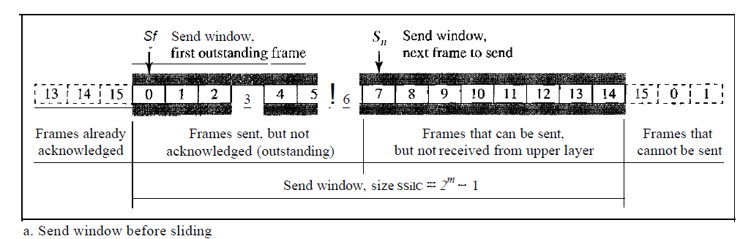
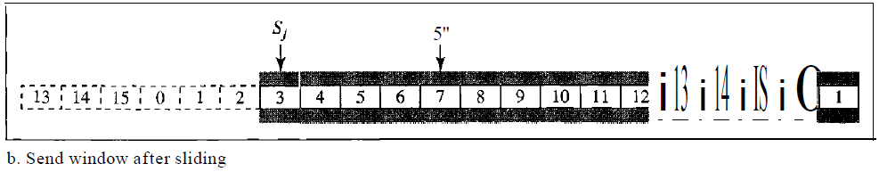
Flow & Error Control in Data Link Layer
Go-Back-N - Sliding Window

Slide 47
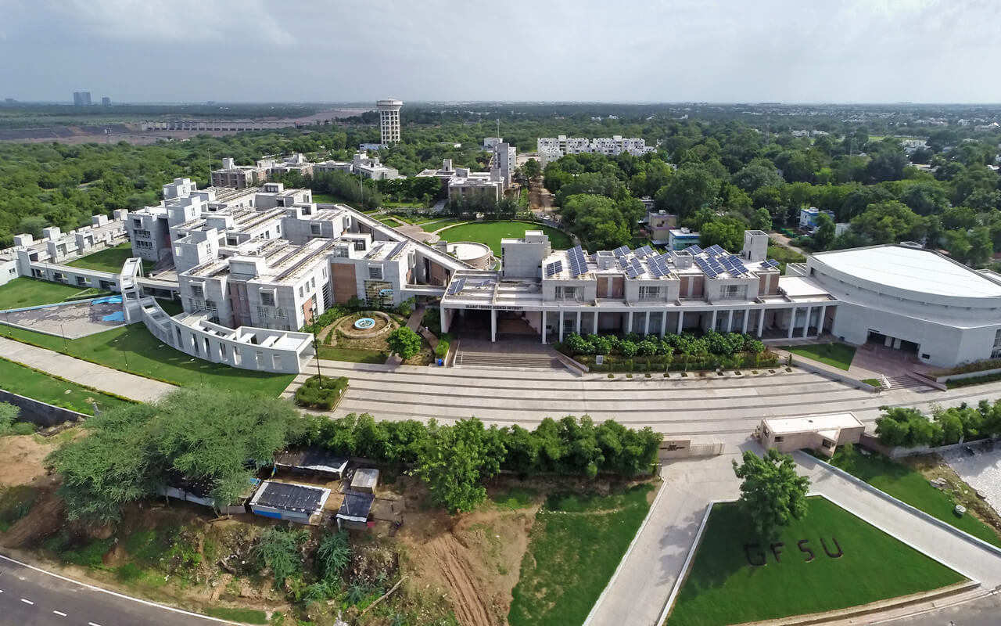




THANK YOU!
Mr. Ramya Shah
ramyashah4@gmail.com
@mr_ramya_shah

